Slide 1

Corporate Social Responsibility and Citizenship
Chapter 3
Copyright ©2020 McGraw-Hill Education. All rights reserved. Authorized only for instructor use in the classroom. No reproduction or further distribution permitted without the prior written consent of McGraw-Hill Education..

Slide 2


Corporate Power and Responsibility
What is Corporate Power?
Positive
More resources.
Lower cost production.
New products.
Technologies.
Negative
Disproportionate
political system.
Dominant public course.
Divide markets.
Squash competition.
Notes:
Corporate Power: Capability of corporations to influence government, the economy, and society, based on their organizational resources.
The tremendous power of the world's leading corporations has both positive and negative effects.

Slide 3
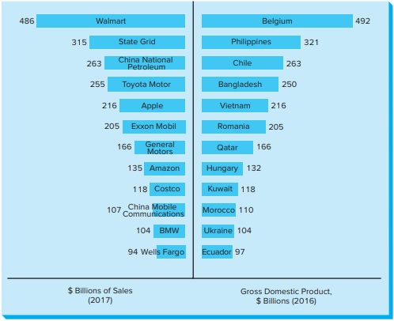
Comparison of Annual Sales Revenue and the GDP for Select Multinational Enterprises and Nations in $ Billions
Figure 3.1
Copyright © McGraw-Hill Education. Permission required for reproduction or display.
Access the text alternative for these images.
Notes:
Compare the power of some corporations in terms of their revenue to some sovereign countries

Slide 4

Corporate Power and Responsibility1
Iron law of responsibility says in the long run, those who do not use power in ways that society considers responsible will tend to lose it.

Slide 5

Consider
The Meaning of
Corporate Social Responsibility
Corporate Citizenship
Notes:
Corporate Responsibility: Act in a way that enhances society and its inhabitants and be held accountable.
Acknowledge any harm to people and society and correct it if possible.
May forgo some profits if its social impacts hurt its stakeholders or if its funds is usable for a positive social impact.
Corporate Citizenship: the actions they take to put their commitments to corporate social responsibility into practice.
The term global corporate citizenship, similarly, refers to putting these commitments into practice worldwide.
Companies demonstrate their corporate citizenship by:
Proactively building stakeholder partnerships.
Discovering business opportunities in serving society.
Transforming a concern for financial performance into a vision of integrated financial and social performance.

Slide 6
Phases of Corporate Social Responsibility
Frederick provides expanded framework for understanding the evolution of the CSR concept.
Divided into 4 phases:
Corporate Social stewardship (1950s-1960s)
Corporate social responsiveness (1960s–1970s)
Corporate/
global citizenship (1990s – 2000s)
Corporate/
business ethics (1980s – 1990s)
Notes:
The Origins of Corporate Social Responsibility
In the United States, the idea of corporate social responsibility appeared around the start of the 20th century.
Corporations under attack for being too big, too powerful, and guilty of antisocial and anticompetitive practices.
To use their power and influence voluntarily for broad social purposes rather than for profits alone.
Example: Steelmaker Andrew Carnegie, Henry Ford.
Example: “new” philanthropists—Mark Zuckerberg, Priscilla Chen.

Slide 7
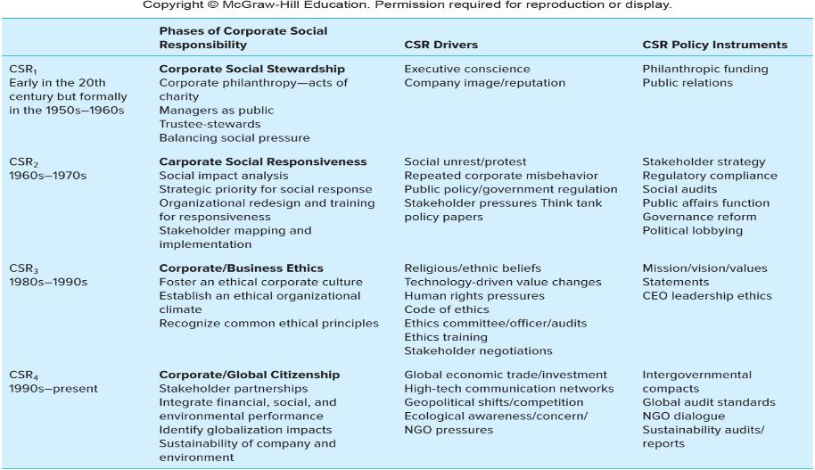
Evolving Phases of Corporate Social Responsibility
Figure 3.2
Access the text alternative for these images.

Slide 8
Balancing Multiple Responsibilities
Multiple responsibilities of business include:
  Economic responsibilities.
  Social responsibilities.
  Legal responsibilities.
Challenge is to balance all three.
Economic responsibilities
Social responsibilities
Legal Responsibilities
Notes:
Successful firm is one which finds ways to meet each of its critical responsibilities and develops strategies to enable the obligations to help each other.

Slide 9

Enlightened Self-Interest
Economic and social goals come together in companies that practice enlightened self-interest.
Notes:
Economic and social goals come together in companies that practice enlightened self-interest.
The company’s self-interest in the long term to provide:
True value to its customers.
Help for its employees to grow and behave responsibility.
Example: Nestlé.

Slide 10

The Corporate Social Responsibility Question
Copyright © McGraw-Hill Education. Permission required for reproduction or display.
Figure 3.3
In Support for Corporate Social Responsibility | Concerns about Corporate Social Responsibility
Balances corporate power with responsibility. Discourages government regulation. Promotes long-term profits for business. Improves stakeholder relationships. Enhances business reputation. | Lowers economic efficiency and profit. Imposes unequal costs among competitors. Imposes hidden costs passed on to stakeholders. Requires skills business may lack. Places responsibility on business rather than individuals.

Slide 11
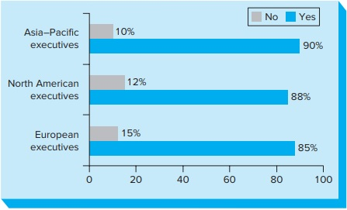
The Role of CSR in Business Strategy
Figure 3.4
Senior executives were asked:
  Is CSR becoming an increasingly important part of your business strategy?
Their responses were:
Copyright © McGraw-Hill Education. Permission required for reproduction or display.
Access the text alternative for these images.

Slide 12

Consider:
Business Reputation
Social Entrepreneurship
B Corporations
Notes:
Business Reputation refers to desirable or undesirable qualities associated with an organization or its actors that may influence the organization’s relationships with its stakeholders.
The Reputation Index measures a company’s social reputation.
It evaluates critical intangible assets that constitute corporate reputation.
Rating Research, a British firm, distributes the index and ratings to interested parties.
Social entrepreneurs are driven by a core mission to create and sustain social rather than economic value.
Social entrepreneurship is the process of identifying a social need and using their entrepreneurial skills to address this need.
Social ventures are the organizations founded by social entrepreneurs.
B Corporations
Must meet rigorous, independent social and environmental performance standards.
Focus on social responsibility and citizenship by blending their social objectives with financial goals.
B Corporation must prove its socially responsible by meeting the B Lab standards.
B Lab is a non-profit organization that assesses a corporation’s social and environmental performance standards.

Slide 13
Stages of Corporate Citizenship
From Figure 3.5
Copyright © McGraw-Hill Education. Permission required for reproduction or display.
Stages | Citizenship Content | Strategic Intent | Leadership | Structure | Issues Management | Stakeholder Relationships | Transparency
Stage 5: Transforming | Change the game | Market creation or social change | Visionary, ahead of the pack | Mainstream; business driven | Defining | Multi-organization | Full disclosure
Stage 4: Integrated | Sustainability or triple bottom line | Value proposition | Champion, in front of it | Organizational alignment | Proactive, systems | Partnership alliance | Assurance
Stage 3: Innovative | Stakeholder management | Business case | Steward, on top of it | Cross-functional coordination | Responsive, programs | Mutual influence | Public reporting
Stage 2: Engaged | Philanthropy, environmental protection | License to operate | Supporter in the loop | Functional ownership | Reactive, policies | Interactive | Public relations
Stage 1: Elementary | Jobs, profits, and taxes | Legal compliance | Lip service, out of touch | Marginal, staff-driven | Defensive | Unilateral | Flank protection
Notes:
Businesses for Social Responsibility (BSR) survey:
The goal of a global citizenship management system is to integrate corporate responsibility and citizenship concerns into a company’s values, culture, operations and decisions at all organizational levels.
One emerging trend is the consolidation of corporate citizenship efforts.
→ Example: Samsung.
Citizenship as an opportunity to:
Create value for their organization.
Gain a competitive advantage.
Help address some of the world’s biggest challenges.

Slide 14

Social Audit Standards
Three different ways:
1. Companies can develop standards designed to set expectations of performance for themselves or their suppliers or partners. Example: Apple.
2. Companies within an industry can agree on a common industry-wide standard.
Example: Responsible Business Alliance (RBA).
3. Can be developed by global nongovernmental organizations or standard-setting organizations.
Example: International Organisation for Standards, Social Accountability 8000, AccountAbility (AA), United Nations Global Compact, The Global Reporting Initiative and others.
Notes:
Social audit: a systematic evaluation of an organization’s social, ethical, and environmental performance.
Six Benefits of Social audits by Simon Zadek:
Help businesses know what is happening within their firm.
Understand what stakeholders think about and want from the business.
Tell stakeholders what the business has achieved.
Strengthen the loyalty and commitment of stakeholders.
Enhance the organization’s decision making.
Improve the business’s overall performance.

Slide 15
Social Reporting
When a company decides to publicize information collected in a social audit.
Transparency: When companies clearly and openly report their performance—financial, social, and environmental.
An emerging trend in corporate reporting is the integration of legally required financial information with social and environmental information into a single integrated report.
Notes:
By 2017, a majority of the largest companies included information of corporate social responsibility in their annual financial reports.
This reflected a dramatic rise in integrated reporting, from 8 percent in 2008 and 51 percent in 2013 to 78 percent by 2017.
Ethical drivers replaced economic considerations (80 percent versus 50 percent) as the primary motivator for publishing reports over the past decade.
Stakeholder engagement increased from about 33 percent to nearly 66 percent, with financial analysts and investors now getting involved.

